Slide 1





Uber Files Massive Leak
Presented by Group 2 :
Haneesh Banisetti
Kush Parmar
Raven Yao Chen
Siddharth Bahekar

Slide 2





Background Information
Personally Identifiable Information
124,000 files including data of 60 millions of users from over 40 countries
5 years' worth of data leaked – 2013 to 2017
Uber admitted to pay thousands of dollars to hackers
Whistleblower, Mark MacGnan disclosed these reports to The Guardian

Slide 3


Main Issue
Constantly forced its ride-hailing services
Aggressive tactics broke laws and regulations
Uber's high-profile employees and government officials involved
Delay in prompt disclosure to affected users
Loss of trust
Legal repercussions
Regulatory scrutiny
Reputational damage
Operational disruptions

Slide 4
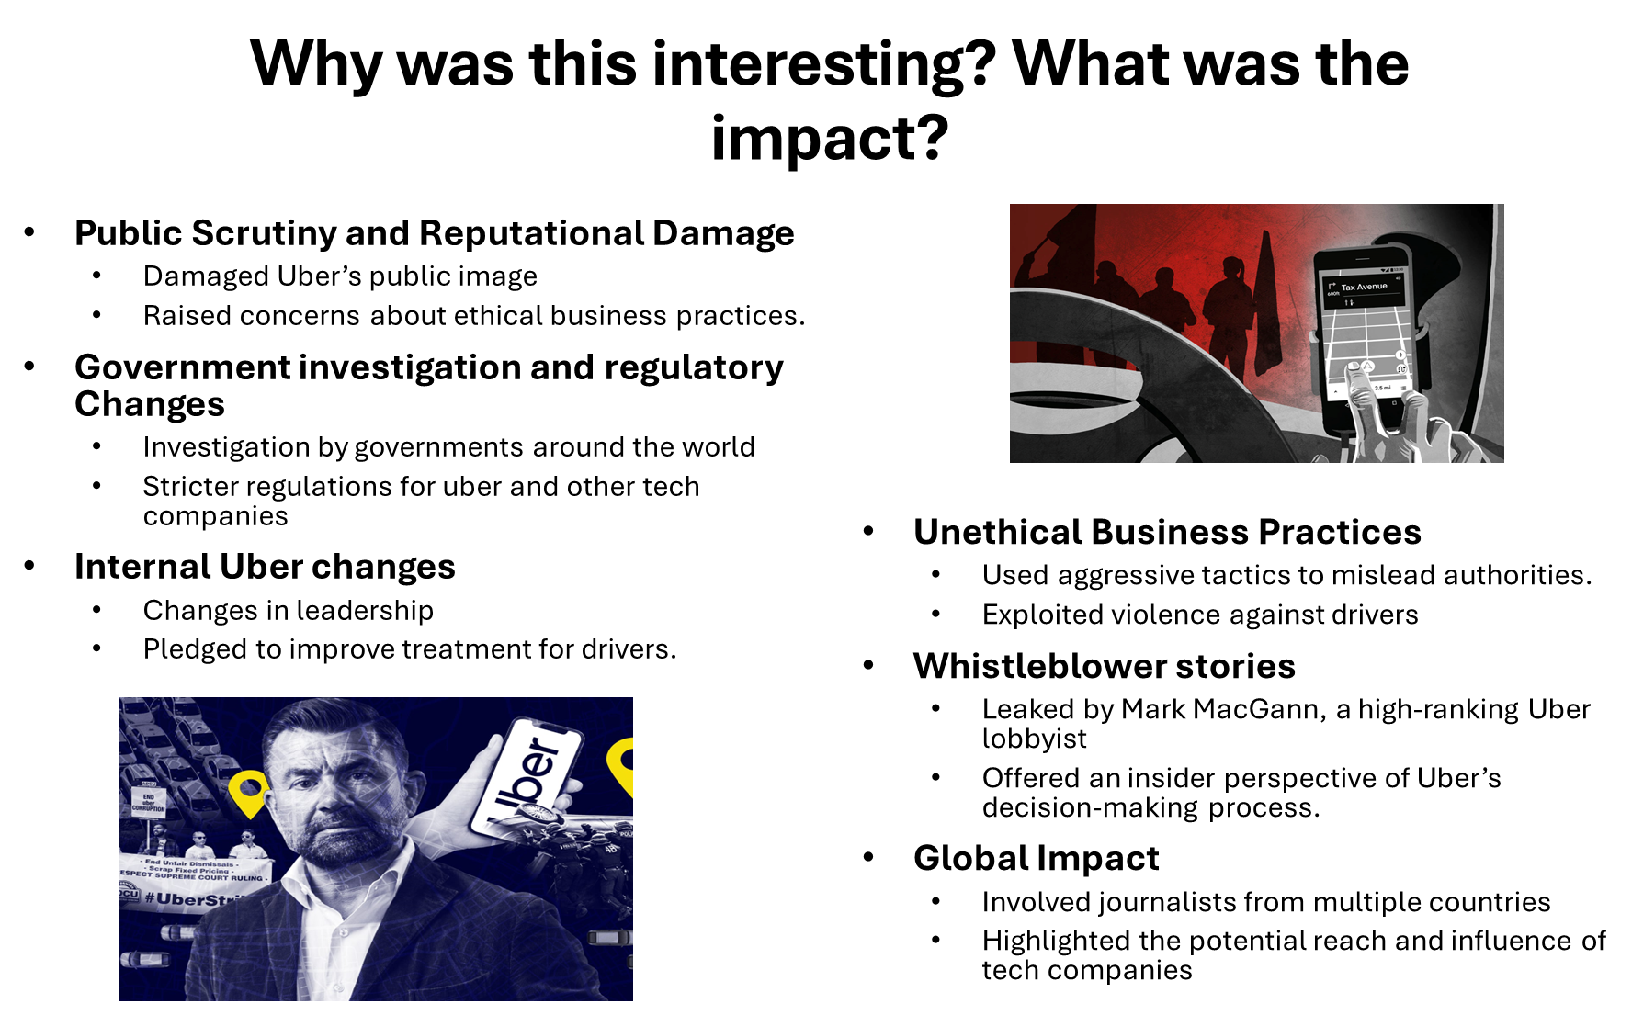

Slide 5
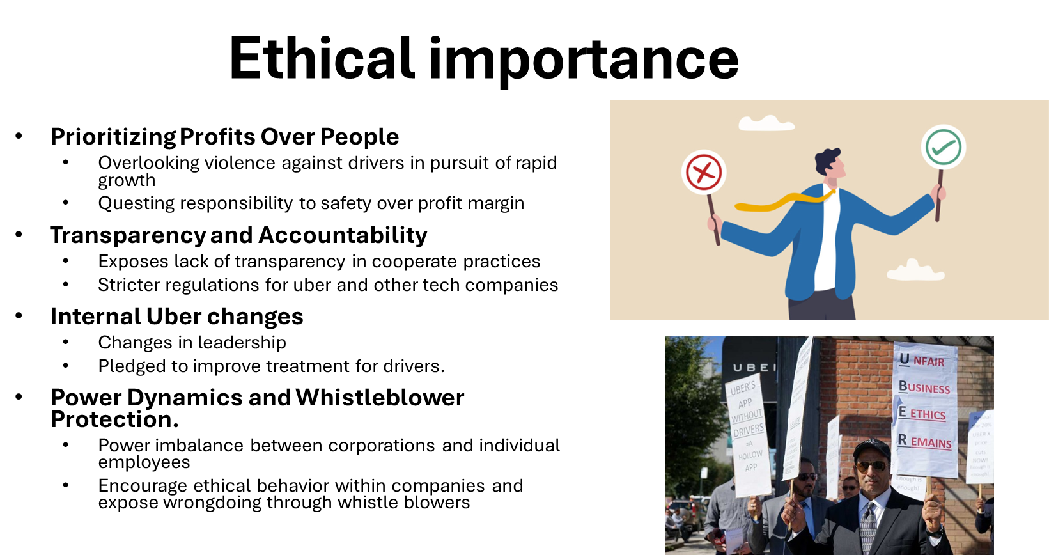

Slide 6
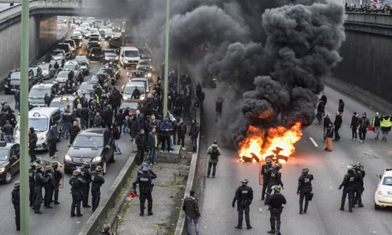
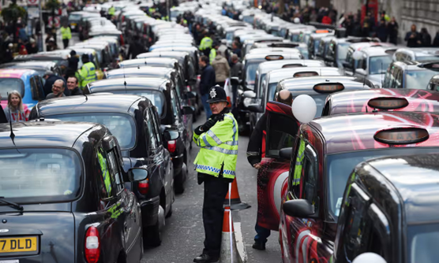

Personal and Public Impact
1. Personal Impact :
Emmanuel Macron's relationship
Neelie Kroes' conduct
2. Public Impact :
Political influence
Regulatory consequences
3. Legal Ramifications :
Violation of laws
Accountability
4. Reputational Damage :
Uber's image
Political fallout
5. Policy Reforms :
Government response
Corporate governance
6. International Scrutiny :
Global attention
Collaborative investigations

Slide 7

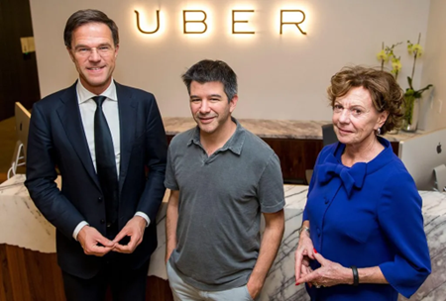
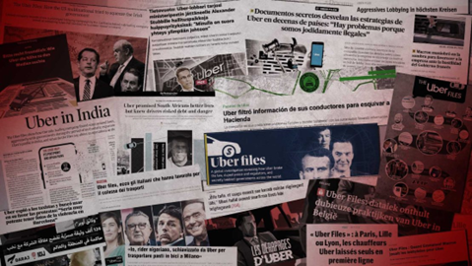
Short term, Long term & Unintended Consequences
Short-Term Consequences :
Increased public scrutiny & backlash
Damage to Uber's reputation
Calls for stricter regulations and transparency
Long-Term Consequences :
Reforms in corporate governance
Inclusion of ethical standards
Shift towards more responsible and accountable behavior
Unintended Consequences :
Erosion of public confidence
Emergence of new whistleblowers
Heightened awareness

Slide 8

Preventability Analysis
Was the case preventable?
Yes!!!✅ The uber data leak was preventable
Company side
Adequate security measures
Public Side
Stricter regulations
What could have been done differently?
Robust encryption protocols
Regular security audits
Strict access control

Slide 9
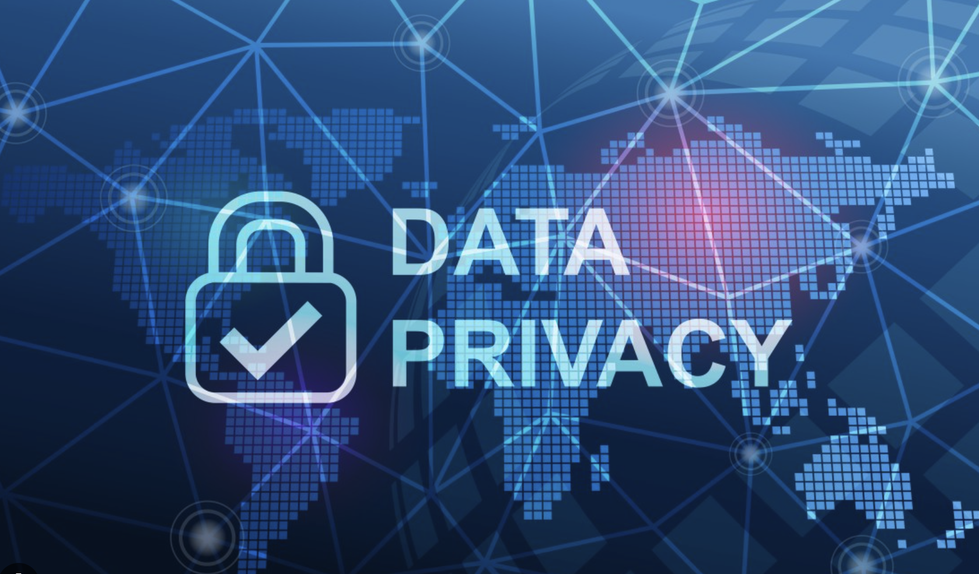
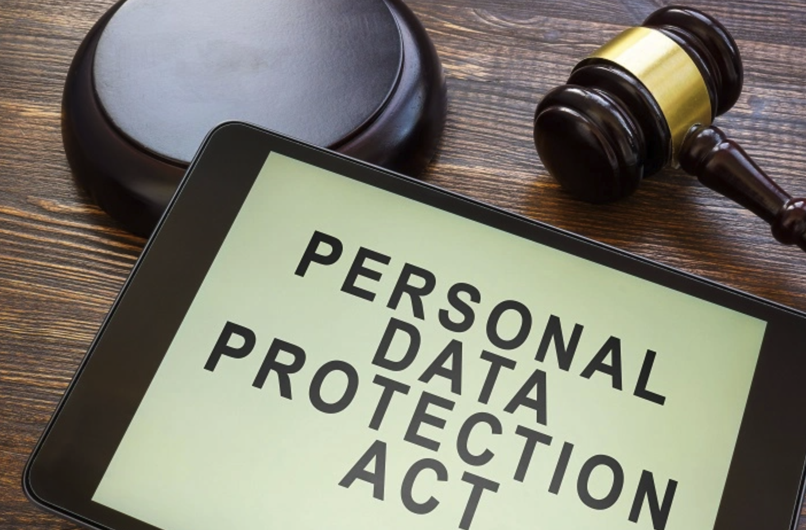
Lessons Learned
Importance of prioritizing data security
Transparency and accountability in breach disclosure
Regulatory compliance with data protection laws

Slide 10
References
Team, B. U. F. R. (2022, July 10). Uber Files: Massive leak reveals how top politicians secretly helped Uber. BBC.
https://www.bbc.com/news/business-62057321
EQS Integrity Line. (2023, November 22). Details behind the whistleblower leak at Uber. https://www.integrityline.com/expertise/blog/details-whistleblower-leak-uber/
Dzakpata, F., & Dzakpata, F. (2022, July 11). Uber Files: Massive leak reveals how top politicians secretly helped Uber. Asaase Radio. https://www.asaaseradio.com/uber-files-massive-leak-reveals-how-top-politicians-secretly-helped-uber/
Davies, H., Goodley, S., Lawrence, F., Lewis, P., O’Carroll, L., & Cutler, S. (2022, August 11). Uber broke laws, duped police and secretly lobbied governments, leak reveals. The Guardian. https://www.theguardian.com/news/2022/jul/10/uber-files-leak-reveals-global-lobbying-campaign
Boland-Rudder, H. (2022, October 27). The Uber files. ICIJ. https://www.icij.org/investigations/uber-files/

